Slide 1

Big Data Infrastructure
CS 489/698 Big Data Infrastructure (Winter 2016)
Week 3: From MapReduce to Spark (2/2)
January 21, 2016
Jimmy Lin
David R. Cheriton School of Computer Science
University of Waterloo
These slides are available at http://lintool.github.io/bigdata-2016w/
This work is licensed under a Creative Commons Attribution-Noncommercial-Share Alike 3.0 United States See http://creativecommons.org/licenses/by-nc-sa/3.0/us/ for details

Slide 2

The datacenter is the computer!
What’s the instruction set?
Source: Google

Slide 3
MapReduce
List[(K1,V1)]
map f: (K1, V1) ⇒ List[(K2, V2)]
reduce g: (K2, Iterable[V2]) ⇒ List[(K3, V3)]
List[K2,V2])

Slide 4
Spark
RDD[T]
RDD[(K, V)]
RDD[(K, V)]
RDD[T]
RDD[T]
RDD[T]
RDD[(K, V)]
flatMap f: (T) ⇒ TraversableOnce[U]
groupByKey
aggregateByKey
seqOp: (U, V) ⇒ U, combOp: (U, U) ⇒ U
map f: (T) ⇒ U
filter f: (T) ⇒ Boolean
mapPartitions f: (Iterator[T]) ⇒ Iterator[U]
RDD[(K, V)]
RDD[(K, W)]
reduceByKey
f: (V, V) ⇒ V
RDD[(K, V)]
RDD[(K, V)]
RDD[(K, W)]
RDD[U]
RDD[(K, Iterable[V])]
RDD[(K, U)]
RDD[U]
sort
RDD[U]
cogroup
RDD[U]
RDD[(K, V)]
join
And more!
RDD[(K, (Iterable[V], Iterable[W]))]
RDD[(K, V)]
RDD[(K, (V, W))]

Slide 5
What’s an RDD?
Resilient Distributed Dataset (RDD)
= immutable
= partitioned
Wait, so how do you actually do anything?
Developers define transformations on RDDs
Framework keeps track of lineage

Slide 6
Spark Word Count
val textFile = sc.textFile(args.input())
textFile
.flatMap(line => tokenize(line))
.map(word => (word, 1))
.reduceByKey(_ + _)
.saveAsTextFile(args.output())

Slide 7
RDD Lifecycle
Transformation
RDD
Action
values
Transformations are lazy:
Framework keeps track of lineage
Actions trigger actual execution

Slide 8
Spark Word Count
RDDs
val textFile = sc.textFile(args.input())
val a = textFile.flatMap(line => line.split(" "))
val b = a.map(word => (word, 1))
val c = b.reduceByKey(_ + _)
c.saveAsTextFile(args.output())
Transformations
Action

Slide 9
RDDs and Lineage
On HDFS
textFile: RDD[String]
.flatMap(line => line.split(" "))
a: RDD[String]
.map(word => (word, 1))
b: RDD[(String, Int)]
.reduceByKey(_ + _)
c: RDD[(String, Int)]
Action!
Remember, transformations are lazy!

Slide 10
RDDs and Optimizations
Lazy evaluation creates optimization opportunities
On HDFS
textFile: RDD[String]
RDDs don’t need to be materialized!
.flatMap(line => line.split(" "))
a: RDD[String]
Want MM?
.map(word => (word, 1))
b: RDD[(String, Int)]
.reduceByKey(_ + _)
c: RDD[(String, Int)]
Action!

Slide 11
RDDs and Caching
RDDs can be materialized in memory!
On HDFS
textFile: RDD[String]
✗
.flatMap(line => line.split(" "))
Cache it!
a: RDD[String]
Fault tolerance?
.map(word => (word, 1))
b: RDD[(String, Int)]
.reduceByKey(_ + _)
c: RDD[(String, Int)]
Action!
Spark works even if the RDDs are partially cached!

Slide 12

Spark Architecture

Slide 13
Compare
namenode
job submission node
namenode daemon
jobtracker
tasktracker
tasktracker
tasktracker
datanode daemon
datanode daemon
datanode daemon
Linux file system
Linux file system
Linux file system
…
…
…
slave node
slave node
slave node

Slide 14
YARN
Hadoop’s (original) limitations:
Can only run MapReduce
What if we want to run other distributed frameworks?
YARN = Yet-Another-Resource-Negotiator
Provides API to develop any generic distribution application
Handles scheduling and resource request
MapReduce (MR2) is one such application in YARN

Slide 15
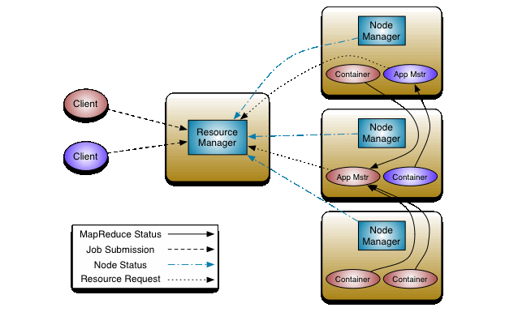
YARN

Slide 16
Spark Programs
Scala, Java, Python, R
spark-shell
spark-submit
Your application
(driver program)
SparkContext
Spark context: tells the framework where to find the cluster
Cluster manager
Local threads
Use the Spark context to create RDDs
Worker
Worker
Spark executor
Spark executor
HDFS

Slide 17
Spark Driver
spark-shell
spark-submit
Your application
(driver program)
val textFile =
sc.textFile(args.input())
textFile
.flatMap(line => tokenize(line))
.map(word => (word, 1))
.reduceByKey(_ + _)
.saveAsTextFile(args.output())
SparkContext
Cluster manager
Local threads
Worker
Worker
Spark executor
Spark executor
What’s happening to the functions?
HDFS

Slide 18
Spark Driver
spark-shell
spark-submit
Your application
(driver program)
val textFile =
sc.textFile(args.input())
textFile
.flatMap(line => tokenize(line))
.map(word => (word, 1))
.reduceByKey(_ + _)
.saveAsTextFile(args.output())
SparkContext
Cluster manager
Local threads
Worker
Worker
Note: you can run code “locally”, integrate cluster-computed values!
Spark executor
Spark executor
HDFS
Beware of the collect action!

Slide 19
Spark Transformations
RDD[T]
RDD[(K, V)]
RDD[(K, V)]
RDD[T]
RDD[T]
RDD[T]
RDD[(K, V)]
flatMap f: (T) ⇒ TraversableOnce[U]
groupByKey
aggregateByKey
seqOp: (U, V) ⇒ U, combOp: (U, U) ⇒ U
map f: (T) ⇒ U
filter f: (T) ⇒ Boolean
mapPartitions f: (Iterator[T]) ⇒ Iterator[U]
RDD[(K, V)]
RDD[(K, W)]
reduceByKey
f: (V, V) ⇒ V
RDD[(K, V)]
RDD[(K, V)]
RDD[(K, W)]
RDD[U]
RDD[(K, Iterable[V])]
RDD[(K, U)]
RDD[U]
sort
RDD[U]
cogroup
RDD[U]
RDD[(K, V)]
join
RDD[(K, (Iterable[V], Iterable[W]))]
RDD[(K, V)]
RDD[(K, (V, W))]

Slide 20
Starting Points
Input File
Input File
InputSplit
InputSplit
InputSplit
InputSplit
InputSplit
InputFormat
RecordReader
RecordReader
RecordReader
RecordReader
RecordReader
“mapper”
“mapper”
“mapper”
“mapper”
“mapper”
Source: redrawn from a slide by Cloduera, cc-licensed

Slide 21
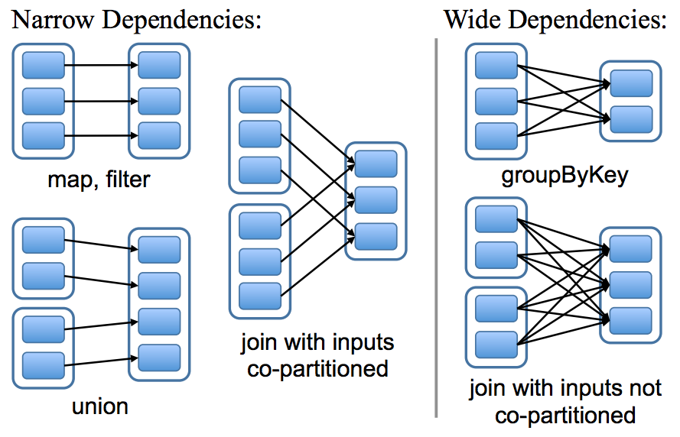
Physical Operators

Slide 22
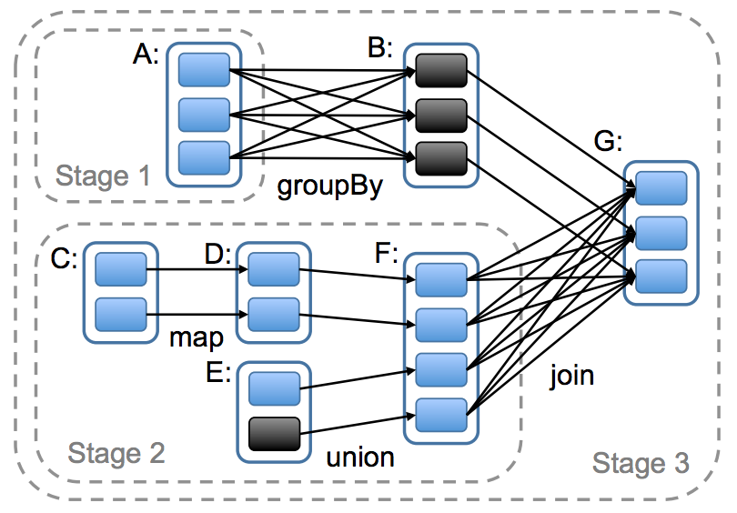
Execution Plan

Slide 23
Can’t avoid this!
…
…

Slide 24
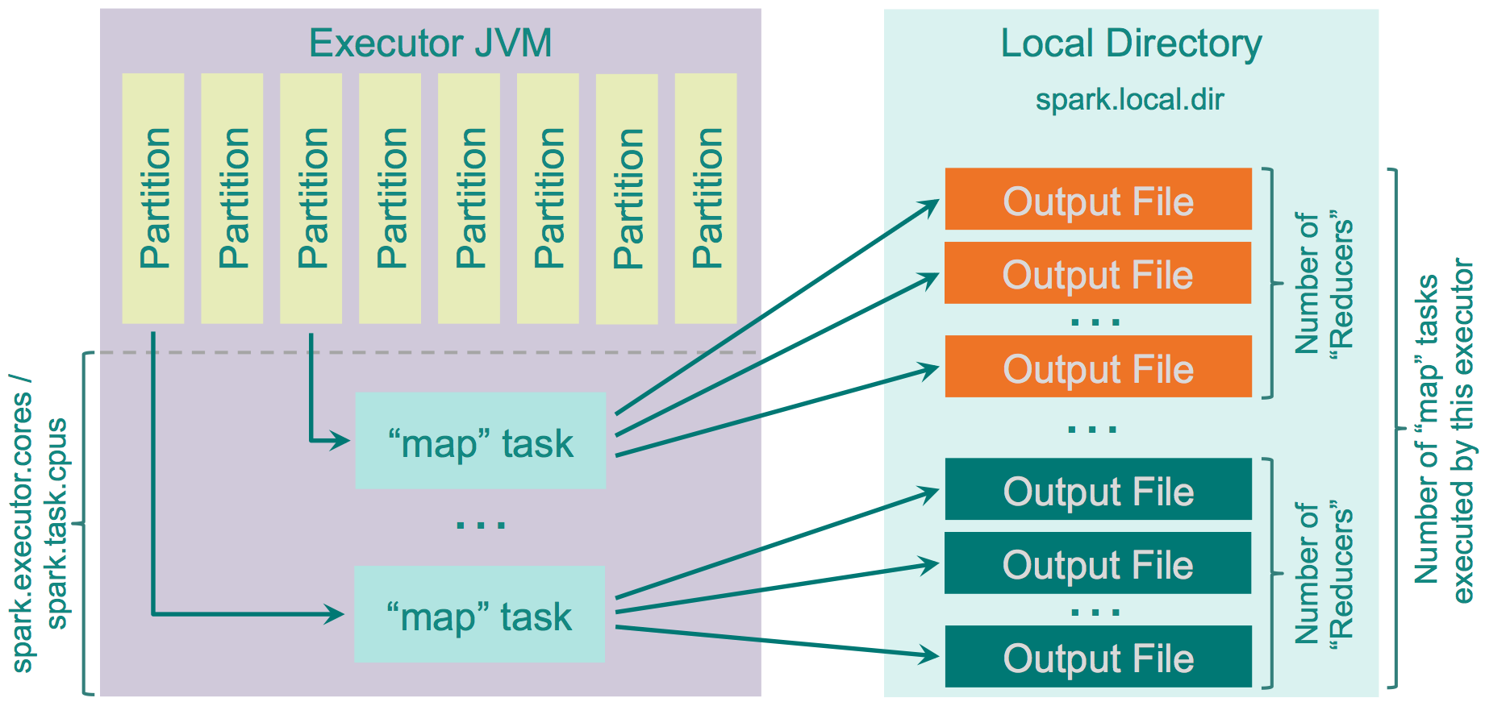
Spark Shuffle Implementations
Hash shuffle
Source: http://0x0fff.com/spark-architecture-shuffle/

Slide 25
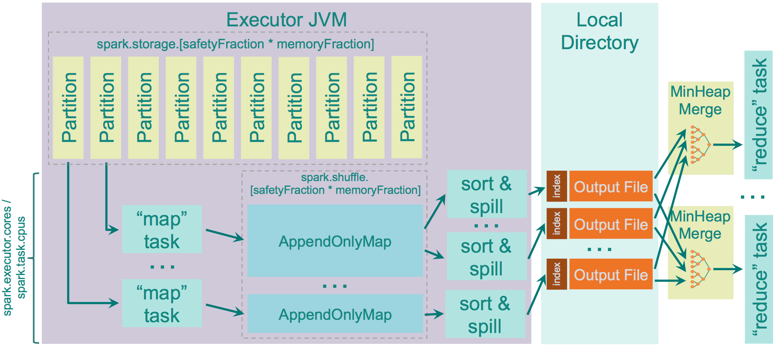
Spark Shuffle Implementations
Sort shuffle
Source: http://0x0fff.com/spark-architecture-shuffle/

Slide 26
Remember this?
Mapper
intermediate files (on disk)
merged spills (on disk)
Combiner
Reducer
circular buffer (in memory)
Combiner
other reducers
spills (on disk)
So, in MapReduce, why are key-value pairs processed in sorted order in the reducer?
other mappers

Slide 27
Remember this?
Mapper
intermediate files (on disk)
merged spills (on disk)
Combiner
Reducer
circular buffer (in memory)
Combiner
other reducers
spills (on disk)
other mappers
Where are the combiners in Spark?

Slide 28
Reduce-like Operations
RDD[(K, V)]
RDD[(K, V)]
reduceByKey
f: (V, V) ⇒ V
aggregateByKey
seqOp: (U, V) ⇒ U, combOp: (U, U) ⇒ U
RDD[(K, V)]
RDD[(K, U)]
How can we optimize?
What happened to combiners?
…
…

Slide 29
Spark #wins
Richer operators
RDD abstraction supports optimizations (pipelining, caching, etc.)
Scala, Java, Python, R, bindings

Slide 30
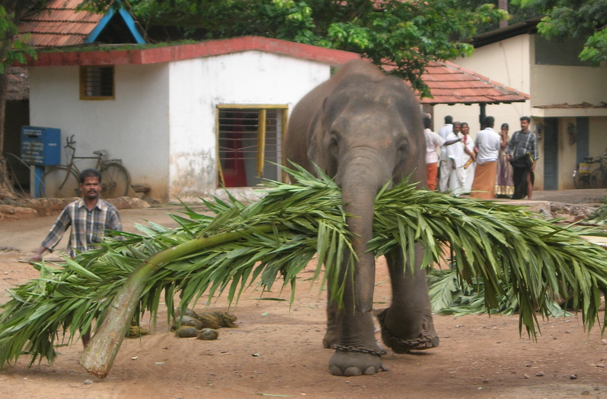
Algorithm design, redux
Source: Wikipedia (Mahout)

Slide 31

Two superpowers:
Associativity
Commutativity
(sorting)
What follows… very basic category theory…

Slide 32
The Power of Associativity
You can put parenthesis where ever you want!
v₁ ⊕ v₂ ⊕ v₃ ⊕ v₄ ⊕ v₅ ⊕ v₆ ⊕ v₇ ⊕ v₈ ⊕ v₉
v₁ ⊕ v₂ ⊕ v₃ ⊕ v₄ ⊕ v₅ ⊕ v₆ ⊕ v₇ ⊕ v₈ ⊕ v₉
v₁ ⊕ v₂ ⊕ v₃ ⊕ v₄ ⊕ v₅ ⊕ v₆ ⊕ v₇ ⊕ v₈ ⊕ v₉
Credit to Oscar Boykin for the idea behind these slides

Slide 33
The Power of Commutativity
You can swap order of operands however you want!
v₁ ⊕ v₂ ⊕ v₃ ⊕ v₄ ⊕ v₅ ⊕ v₆ ⊕ v₇ ⊕ v₈ ⊕ v₉
v₄ ⊕ v₅ ⊕ v₆ ⊕ v₇ ⊕ v₁ ⊕ v₂ ⊕ v₃ ⊕ v₈ ⊕ v₉
v₈ ⊕ v₉ ⊕ v₄ ⊕ v₅ ⊕ v₆ ⊕ v₇ ⊕ v₁ ⊕ v₂ ⊕ v₃

Slide 34
Implications for distributed processing?
You don’t know when the tasks begin
You don’t know when the tasks end
You don’t know when the tasks interrupt each other
You don’t know when intermediate data arrive
…
It’s okay!

Slide 35
Fancy Labels for Simple Concepts…
Semigroup = ( M , ⊕ )
⊕ : M × M → M, s.t., ∀m₁, m₂, m₃ ∋ M
(m₁ ⊕ m₂) ⊕ m₃ = m₁ ⊕ (m₂ ⊕ m₃)
Monoid = Semigroup + identity
ε s.t., ε ⊕ m = m ⊕ ε = m, ∀m ∋ M
Commutative Monoid = Monoid + commutativity
∀m₁, m₂ ∋ M, m₁ ⊕ m₂ = m₂ ⊕ m₁
A few examples?

Slide 36
Back to these…
RDD[(K, V)]
RDD[(K, V)]
reduceByKey
f: (V, V) ⇒ V
aggregateByKey
seqOp: (U, V) ⇒ U, combOp: (U, U) ⇒ U
Wait, I’ve seen this before?
RDD[(K, V)]
RDD[(K, U)]

Slide 37
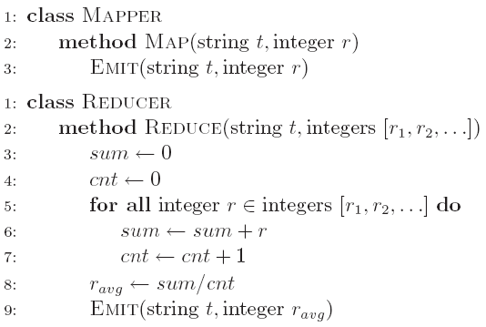
Computing the mean v1 (again)

Slide 38
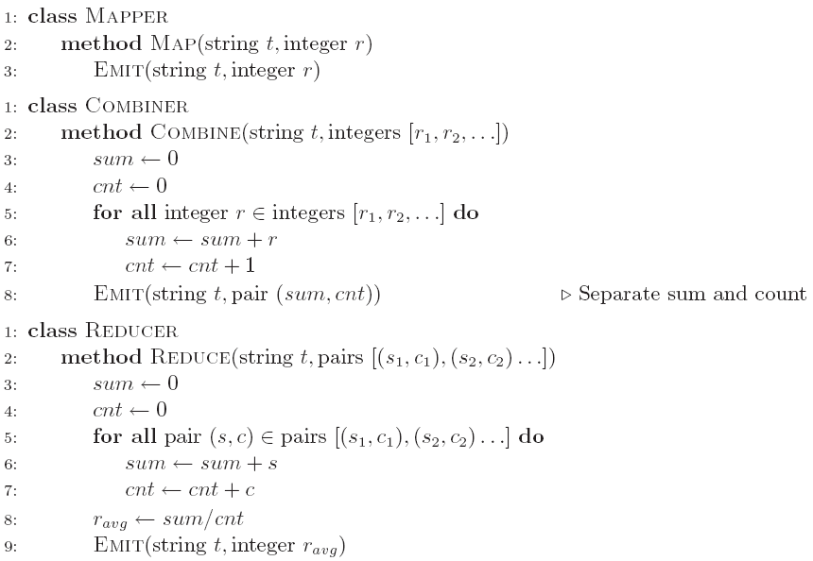
Computing the mean v2 (again)

Slide 39
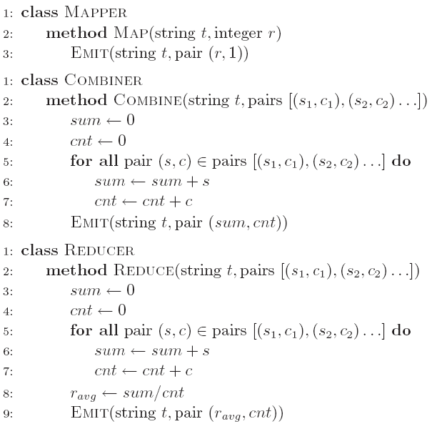
Computing the mean v3 (again)
Wait, I’ve seen this before?
RDD[(K, V)]
reduceByKey
f: (V, V) ⇒ V
RDD[(K, V)]

Slide 40
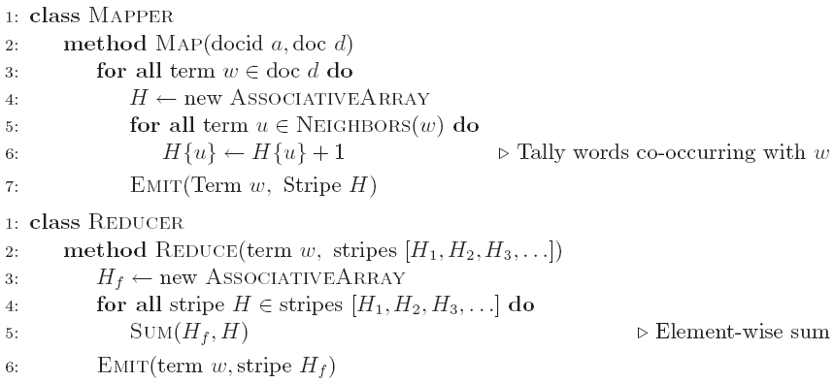
Co-occurrence Matrix: Stripes
Wait, I’ve seen this before?
RDD[(K, V)]
reduceByKey
f: (V, V) ⇒ V
RDD[(K, V)]

Slide 41
Synchronization: Pairs vs. Stripes
Approach 1: turn synchronization into an ordering problem
Sort keys into correct order of computation
Partition key space so that each reducer gets the appropriate set of partial results
Hold state in reducer across multiple key-value pairs to perform computation
Illustrated by the “pairs” approach
Approach 2: construct data structures that bring partial results together
Each reducer receives all the data it needs to complete the computation
Illustrated by the “stripes” approach
What about this?
Commutative monoids!

Slide 42
f(B|A): “Pairs”
For this to work:
Must emit extra (a, *) for every b_{n} in mapper
Must make sure all a’s get sent to same reducer (use partitioner)
Must make sure (a, *) comes first (define sort order)
Must hold state in reducer across different key-value pairs
(a, *) → 32
Reducer holds this value in memory
(a, b₁) → 3
(a, b₂) → 12
(a, b₃) → 7
(a, b₄) → 1
…
(a, b₁) → 3 / 32
(a, b₂) → 12 / 32
(a, b₃) → 7 / 32
(a, b₄) → 1 / 32
…

Slide 43
Two superpowers:
Associativity
Commutativity
(sorting)

Slide 44
Because you can’t avoid this…
…
…
And sort-based shuffling is pretty efficient!

Slide 45
The datacenter is the computer!
What’s the instruction set?
Source: Google

Slide 46
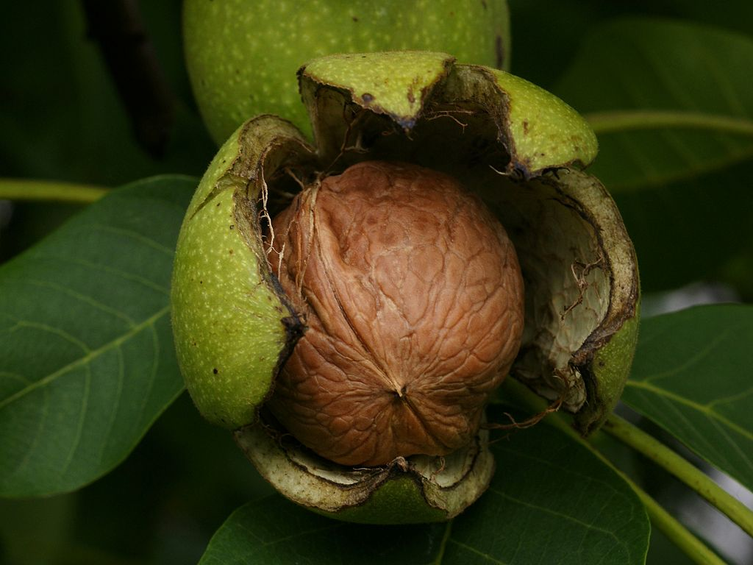
Algorithm design in a nutshell…
Exploit associativity and commutativity via commutative monoids (if you can)
Exploit framework-based sorting to sequence computations (if you can’t)
Source: Wikipedia (Walnut)

Slide 47

Questions?
Remember: Assignment 2 due next Tuesday at 8:30am
Source: Wikipedia (Japanese rock garden)

